Slide 1


Making teamwork ‘work’ in online classes
Dr Victoria Clout
School of Accounting
UNSW

Slide 2







scope
This talk
F2F Teams teaching
BDL - technology
This Photo by Unknown Author is licensed under CC BY-SA

Slide 3

This talk will consider both the Asynchronous and Synchronous
Synchronous
(Live Class)
Asynchronous
(Moodle)

Slide 4
(1) Asynchronous components to enable teamwork

Slide 5

Do you require teams to do work together outside of class?

Slide 6
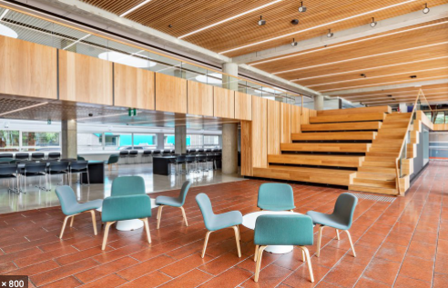
Build a place for students to work together

Slide 7
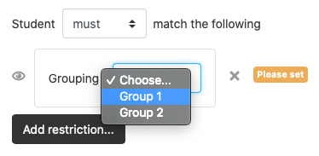



Use the ‘Group’ setting, create Teams as ‘Groups’
On Moodle
A Collaborate link for the team for meetings – you may need to give them a ‘presenter’ link
An Open Forum discussion board for the team to discuss ideas
A Team Wiki page
Then add to the Moodle site activities like…

Slide 8
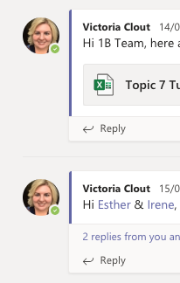

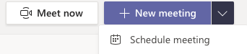
Microsoft Teams:
Setup spaces by…
  Create a team channel – where it is private (only the team can access)
  Students can schedule video meetings using the calendar
  Discuss Ideas and upload documents in their “Channel”

Slide 9


Please don’t leave students to do group chat/discussion on Facebook as a default
Teams don’t always become friends…

Slide 10



How will students submit their work?
Assignment Tool
Turnitin Tool
Email
This submission tool will also determine the way feedback is returned to students. Additional option – feedback can be via the ReView tool.

Slide 11
(2) Synchronous live classes in teams

Slide 12
Consider a smaller team size compared to F2F
For example
3 to 4 students
It takes longer for teams to communicate in an online environment compared to F2F
Can take longer due to less physical social cues
Time talking can increase per student due to technology can mean lagging video/audio feeds

Slide 13
Time considerations
Free responses are going to take longer than MCQs
Give students a time limit on how long they will be in the breakout groups
Try to split up class time between the breakout groups and bring students back together as a class

Slide 14
Provide a time structure at the beginning of class
Here is an example for a 2 hour class:
Start | End | Min | Activity | Format
9:45AM | 10:00AM | 15 | Class door opens Chat introductions & login to the response system (e.g. GoogleDoc or Socrative or Echo360) | Plenary session
10:00AM | 10:20AM | 20 | Session begins Orientation of what to expect How to login to the response system | Plenary session
10:20AM | 10:35AM | 15 | Individual quiz | Individual quiz in Plenary session
10:35AM | 10:50AM | 15 | Instructions for teams Breakout into teams Team introductions Team quiz | Team quiz in virtual break-out room
BREAK |  | 5 | BREAK
10:55AM | 11:10AM | 15 | Clarifications / ”Burning Questions” | Plenary session
11:10AM | 11:30AM | 20 | Application or Short answer extended Team activity | Team application/activity in virtual break-out room
11:30AM | 11:50AM | 20 | Discussion/Gallery-Walk of answers | Plenary session
11:50AM | 12:00PM | 10 | Closing (Feedback survey / Team peer evaluation activity) | Plenary session
Adapted from: https://www.intedashboard.com/

Slide 15

Breakout groups

Slide 16







Be very clear to students about what task you would like them to complete before clicking on the ‘breakout’ groups button more than f2f (because the team can’t run back to you to clarify as easily as a live class)
In F2F in one room
Virtual Distance due to break-out group structure
What are we supposed to do?
More of a problem for Collaborate Ultra and Zoom
Can have a work-around in Microsoft Teams)

Slide 17




Pick a
WRITING or
ANSWER SPACE for teams
Choose a method for students to see the question in the breakout group
& Fill in their answers
Other options…
Miro shared whiteboard
Qualtrics survey
Microsoft Forms
Kahoot
Moodle quiz tool
etc
Yes there are many
more options out there… infinite maybe….

Slide 18








Google Doc approach:
Students then come back to the main room with their answers written in their GoogleDoc
Write up answer
Send link
Write up answer
Send link
GoogleDoc
Send link
Write up answer
Presented by students
Or
Gallery Walk-through by
Lecturer/Tutor
Questions here
Send link
Write up answer

Slide 19

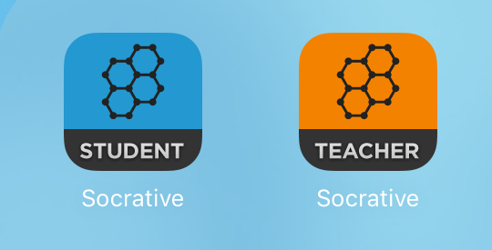


Quiz approach:
UNSW funded
Use a quiz response system during the class to capture responses for example:
Socrative (benefit is it has a team mode, does have a free mode; disadvantage class list requires paid mode).
Echo360 slide deck (disadvantage fiddling required for step for only one class at a time, it’s more for lecture streams need to be created for each class/tutorial stream).
Collaborate Ultra does have a quiz system but it is limited to just MCQ or Yes/No polls and has a short text length for questions.
Microsoft Teams – if you use the “Polly” app in the chatbox this can be used to poll questions. The free version can’t have preloaded questions. The paid version can.
https://socrative.com
Built into Moodle via Plug-in Link

Slide 20
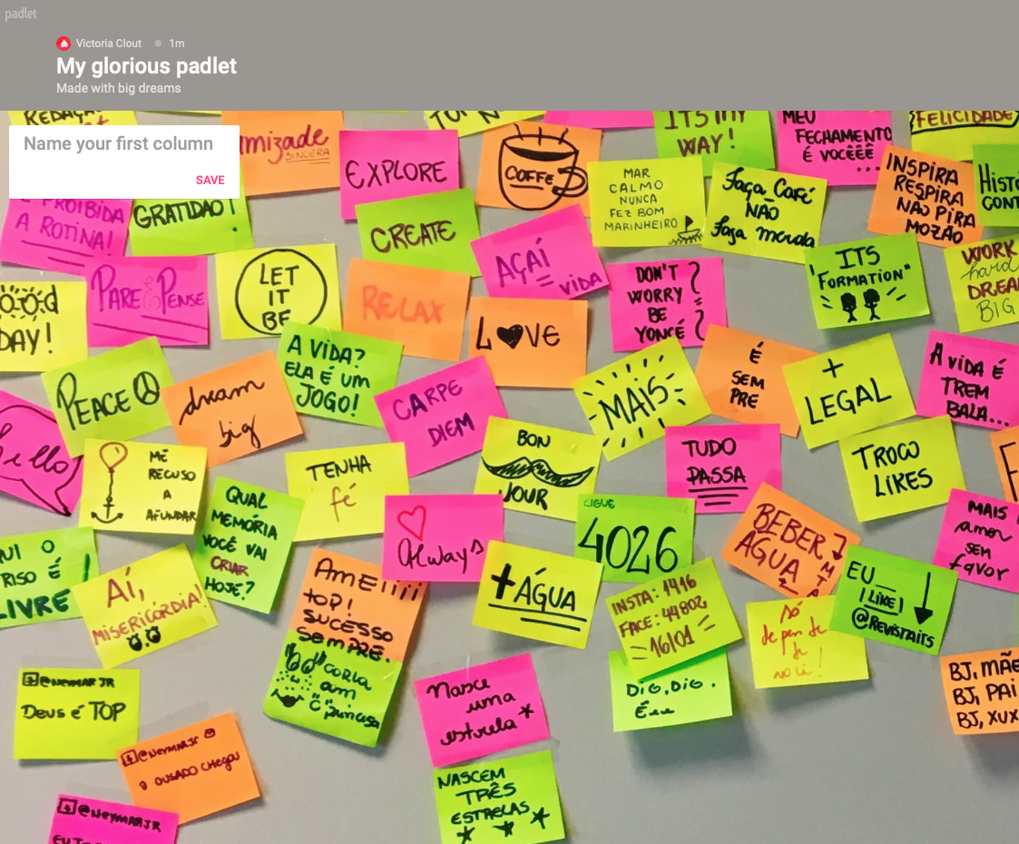
Padlet - post-it note wall approach
https://padlet.com/
3 Free walls… then you have to pay for more walls
See the real-time typing of answers
Headings for topics/questions/ideas

Slide 21
Back in the plenary session
Here are two ideas for on commenting on teams’ responses
Gallery walk approach for short answers
MCQs could be to show the team’s responses and then call on a team, for example ‘Team 2 why did you pick B?’

Slide 22

What platform is best to deliver the class?

Slide 23


you might be using a pre-existing live stream tool….

Slide 24
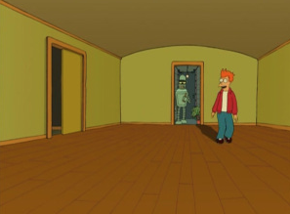

However there could be a better one!

Slide 25

Consideration - the platform should be selected based on your team structure during the Term
Fixed Teams For Whole Term
Random Teams, not required to work
in the same team each time
OR
OR
Teams and Zoom can have fixed teams that can be sent into the breakout rooms (meetings) easily.
Whereas Collaborate Ultra you have to spend time specially forming the teams each time by clicking, which can take 1 to 2 minutes.

Slide 26

Facilitating the breakout groups
Communicate to students if you plan on visiting their breakout groups, otherwise…

Slide 27

Could be a…

Slide 28
In MS Teams – you be on hand for all the breakout groups
Steps are: (1) Go to the MS Teams website in a browser, login using z1234567@ad.unsw.edu.au format;
Step (2): then click on the 'open in desktop app' option,
Step (3): open as many tabs as there are teams and join each of those ‘meetings’ breakout teams.
Also another suggestion – you can use multiple devices (e.g. if you have an iPad, phone, laptop these can all be use to launch different teams breakout groups).

Slide 29

GHOSTING
Team Peer review
Consider more frequent peer evaluations compared to F2F
Be aware of potential ‘ghosting’ by team members. Online environment can make ghosting easier.
Try every 2 to 3 weeks for evaluations.

Slide 30


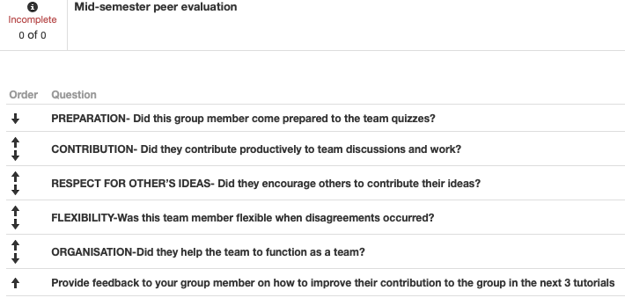
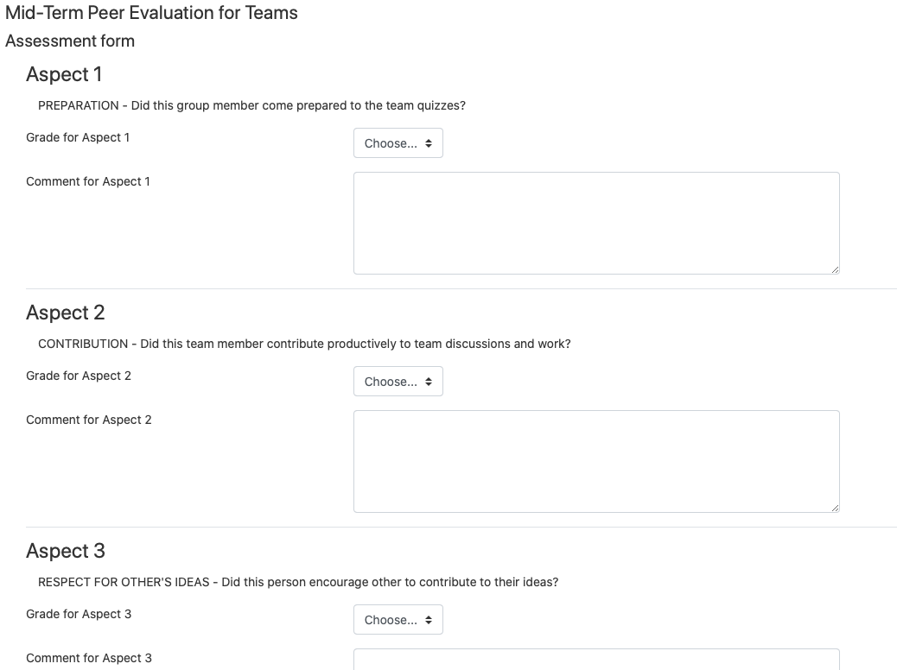
Team Peer evaluation tool suggestions:

Slide 31




Team formation
Moodle Tools available:
Check out my LinkedIn article on this topic:
https://www.linkedin.com/pulse/using-group-allocations-victoria-clout
Python Tool – GroupEng for Team Sorting:
https://www.groupeng.org

Slide 32


Final thoughts…
Synchronous
(Live Class)
Asynchronous
(Moodle)
Just because you have a hammer not every problem is a nail… consider the tools you are using?
Test, test, test… pretend to be a student in a class. See how it feels to go into a breakout group
Consider how you will leverage off the asynchronous online components, e.g. polls/quizzes before class

Slide 33

Thank You for attending & any questions?

Slide 34
Victoria has two more presentations coming up:
Date/time | Presenter/ Facilitator | Topic | Registration Link
27 May 10am-11am | Victoria Clout | Facilitating Synchronous Online Environments | Coming soon link!
27 May 3-4pm | Victoria Clout & Natalie Oh | Learning from T1 – What do Students Need from You? | link

